Slide 1

EXECUTIVE BRIEFING · AI STRATEGY
Pan-European Aparthotel AI Strategy
119K+
1 of 3
Real booking
records analysed
Use cases built
& tested (UC2)
Evidence from 119,388 real hotel bookings
UC2 built & tested end-to-end · UC1 & UC3 scoped · One pilot recommendation
37.5%
PILOT
Current
cancellation rate
Our
recommendation
Daria Bystrova · Ironhack Project 5 · June 2026

Slide 2
MARKET CONTEXT — WHY AI IN HOSPITALITY NOW
Three market forces make inaction the riskiest choice — the window to lead is now
71%
+17%
<18mo
8–14%
of hospitality
professionals say AI
has significant impact
total revenue uplift
for AI-enabled revenue
management vs peers
payback on AI pricing
& personalisation
(McKinsey research)
RevPAR advantage:
EU tech-forward operators
vs peers
Canary Technologies 2026
Hotel Technology News, Dec 2025
McKinsey via AI for Hospitality
Operator materials 2024–25
$2.28B — AI hospitality market by 2030 (CAGR 57.7%, Business Research Co.) · Competitors are answering 'how fast?' — not 'should we?' · The window to lead is now
CONFIDENTIAL · CLEO CEO BRIEFING · JUNE 2026 · DARIA BYSTROVA — IRONHACK PROJECT 5

Slide 3
AI ADOPTION DASHBOARD (PLOTLY)
Six evidence charts confirm the business case — AI adopters outperform on every measurable dimension
Built with: Plotly (Python) · Self-contained interactive HTML · Open ai_adoption_dashboard.html in any browser for live hover & source citations · Unlike Tableau, no server licence needed
Sources: Canary Technologies 2026 · Business Research Co. Apr 2026 · Hotel Technology News Dec 2025 · McKinsey/Ricci Apr 2026 · HVS European Serviced Apts Jul 2025 · *Charts 4 & 6 are directional estimates from composite sources
CONFIDENTIAL · CLEO CEO BRIEFING · JUNE 2026 · DARIA BYSTROVA — IRONHACK PROJECT 5

Slide 4
CRITICAL ANALYSIS — HYPE VS EVIDENCE · WHAT THE DATA ACTUALLY SUPPORTS
Not all AI claims are equal — verdicts based on: our own 119K booking data · cited industry research · first-hand LLM build experience
INVEST = confirmed by our data or ≥2 independent cited sources · PILOT = real effect but outcome depends on Cleo’s specific context · HYPE = vendor claim exceeds evidence or carries unacceptable risk at this company size
✅ INVEST — CONFIRMED BY EVIDENCE
⚠ PILOT — REAL BUT CONTEXT-DEPENDENT
❌ HYPE — OVERCLAIMED OR RISKY HERE
Cancellation prediction
Headcount reduction 30–50%
Autonomous pricing, no human override
Own 119K data: r=+.293 lead time, groups 61.1%, OTA 2.3× Direct
Vendor claim · automation handles routine only · complex comms still need humans
OTA rate parity clauses · EU AI Act human oversight requirement · manager trust gap
→ Signals are strong, consistent, and available in Cleo’s PMS today
→ Measure actual time saved in pilot before any staffing decisions
→ Rules engine + human approval first · autonomous only after 12mo trust-building
Dynamic pricing +10–15% ADR
AI forecasting +20% accuracy
Need ML team to start
Hotel Tech News Dec 2025 · Our data: €5.42 gap on 20.9% demand swing
True vs legacy RMS · may be smaller vs Cleo’s current human forecasting
We built: LangChain agent + 11 tools + n8n workflow + Tableau — one analyst, zero ML engineers
→ Gap confirmed in our data — near-zero current pricing = high upside
→ Validate against your actual baseline before buying a new RMS
→ Start lean · add ML capability only if pilot proves ROI
McKinsey: 3–10% revenue uplift
AI chatbot NPS +10–15
McKinsey/Ricci Apr 2026 · <18mo payback · credible non-vendor source
Variable outcomes · good for simple queries · damages satisfaction without escalation path
→ Conservative end (3–5%) is achievable; not vendor marketing
→ Design human handoff first · Phase 4 consideration, not Phase 1
EU early movers: 8–14% RevPAR gap
BobW/Limehome/Numa investor materials 2024–25 · HVS Jul 2025
→ Competitive pressure is real even if exact % is a directional estimate
Special requests = protective signal
Own data: 0 requests → 48% cancel · 4+ requests → 5% cancel (r=−0.235)
→ Cheap, immediate action — send preference surveys pre-arrival
First-hand evidence from building this system: self-evaluation bias confirmed (same model generated and judged = inflated 4.6/5) · hallucination when tools have no data · prompt sensitivity affects output quality · full reasoning in hype_vs_evidence.md
CONFIDENTIAL · CLEO CEO BRIEFING · JUNE 2026 · DARIA BYSTROVA — IRONHACK PROJECT 5

Slide 5
THREE USE CASES · WHAT EACH SOLVES · REVENUE OPPORTUNITY CALCULATION FROM DATASET DATA ONLY
UC2 is the only use case with confirmed calculations — UC1 problem is proven, UC3 tools built but no output numbers presented
Dataset basis: Kaggle Hotel Booking Demand · 2 Portuguese hotels (Lisbon city + Algarve resort) · July 2015–Aug 2017 · 119,390 bookings · 32 columns · Applied to Cleo as directional proxy — must be validated against Cleo's own PMS in Phase 1
UC2 — CANCELLATION PREDICTION
UC1 — DYNAMIC PRICING
UC3 — UPSELL AUTOMATION
What it solves: flag high-risk bookings before they cancel
What it solves: capture revenue gap on high-demand nights
What it solves: personalised pre-arrival upsells at scale
CONFIRMED FROM DATASET
CONFIRMED FROM DATASET
CONFIRMED FROM DATASET
• 119,390 total bookings
• €5.42 ADR gap: peak (Oct €118.43) vs low (May €113.00)
• 74,619 stayed bookings — potential upsell targets
• 37.5% cancellation rate = 44,771 cancellations
• 20.9% demand swing across months
• 10+ cities, 500 employees — manual upsells impossible
• ADR €118 · avg stay 3.0 nights (city hotel)
• 74,619 stayed bookings · 15,595 in peak months
• Tools built: upsell_opportunity(), repeat_guest(), guest_origin()
• OTA cancels at 41% vs Direct 17.5%
• ADR €118 · avg stay 3.0 nights
• Agent ran all 3 tools · output in raw_insights.json
CALCULATION
CALCULATION
CALCULATION
44,771 cancellations × 10% recovery (est.)
× €118 ADR × 3.0 nights
15,595 peak bookings × 50% of
€5.42 gap × 3.0 nights
⚠ No confirmed output numbers from this dataset.
Agent output exists in raw_insights.json only.
€1.6M conservative
€127K conservative
Cannot calculate
at 10% recovery · €3.2M at 20% recovery
ADR gap only — volume uplift not calculable from this data
Requires Cleo's actual upsell conversion data from PMS
UC1 + UC2 combined conservative: €1.6M (UC2) + €127K (UC1) = €1.7M minimum · All figures from Kaggle dataset (2 Portuguese hotels, 2015–2017) applied as proxy — validate against Cleo PMS in Phase 1
CONFIDENTIAL · CLEO CEO BRIEFING · JUNE 2026 · DARIA BYSTROVA — IRONHACK PROJECT 5

Slide 6
FULL SOLUTION ARCHITECTURE — DATA FLOW · AGENT · INSIGHTS · EVALUATION · EMAIL TRIGGER
① INPUT &
AGENT
bookings_clean.csv
tools.py — 11 pandas tools
agent.py — LangChain agent
raw_insights.json
119,390 rows · 32 columns
Kaggle — 2 Portuguese hotels
(Lisbon city + Algarve resort)
July 2015 – Aug 2017
Proxy for Cleo PMS data
UC1 Pricing (4): adr_statistics,
seasonal_pricing, weekend_adr,
stay_length_adr
UC2 Cancel (4): cancel_rate,
lead_time, correlation, deposit_type
UC3 Upsell (3): upsell_opp, repeat_guest, origin
LLM: Claude Sonnet / GPT-4
(swappable via .env)
bind_tools loop — LLM plans
which tool to call next
Every step logged to terminal
Fully auditable
10 structured insights
Each insight contains:
· headline
· evidence
· source_tool
· limitation
· action
② EVAL
EVALUATION LOOP — WHAT IT CHECKS
insight_review.py — LLM judge
evaluation_results.json
Is the insight relevant to a hospitality CEO?
Are the numbers plausible given the data?
Is there a specific action Cleo can take?
Is it written in plain business language?
Goal: quality-gate before any insight reaches a
decision-maker — human review supplements scores
System prompt defines 4 criteria:
· Relevance (1–5)
· Accuracy (1–5)
· Actionability (1–5)
· Clarity (1–5)
Same model scores raw_insights.json
Outputs score + reasoning per insight
⚠ Self-evaluation bias — see slide 8
Per-insight scores × 4 dims
Overall average: 4.6 / 5.0
Reasoning logged per dimension
NOT fed back into agent
— static evaluation only
— bias note: same model
③ KEY
FINDINGS
KEY FINDINGS FROM AGENT (UC2 confirmed) — used to set n8n trigger rules below
OTA cancels 41%
vs Direct 17.5%
365d+ bookings
cancel at 68%
No-deposit =
high cancel rate
Special requests
= protective
→ flag channel = OTA
→ flag lead_time > 90d
→ flag deposit = none
→ reduce risk if req > 0
④ EMAIL
TRIGGER
n8n WEBHOOK
RISK FILTER
LLM — GPT-3.5
GMAIL SEND
AUDIT LOG
Trigger: new PMS booking created
6 fields passed:
· guest_email
· lead_time
· channel
· segment
· booking_id
· check-in date
IF channel = OTA
OR lead_time > 90
OR deposit = none
THEN → high risk
→ pass to LLM
ELSE → skip
(no email sent)
Generates personalised
retention email body
Facts: all from PMS
LLM: tone only
→ hallucination on
facts impossible
Human can override
Email to guest
~2 seconds after
booking entry
✅ TESTED LIVE:
webhook → inbox
in 2 seconds
real bookings
Google Sheets
Timestamp per action
Booking ID
Email subject
Risk score
Human override flag
⑤ REPORT
TABLEAU DASHBOARD — UC2 Cancellation & No-Show Risk (connected to bookings_clean.csv)
Cancellation by channel · Lead time risk curve · Monthly trend (flat 37%) · Special requests signal · City vs Resort · Market segment risk
Human override at every step · All tool calls logged · LLM personalises tone only — all facts from PMS · GDPR review before go-live · Validate Cleo PMS data quality in Phase 1
CONFIDENTIAL · CLEO CEO BRIEFING · JUNE 2026 · DARIA BYSTROVA — IRONHACK PROJECT 5

Slide 7
DATA FLOW & EVALUATION — FROM RAW DATA TO AUDITABLE INSIGHTS
The system scores 4.6/5 across four business-quality dimensions — bias acknowledged, mitigation plan in place
RAW DATA
PANDAS
TOOLS
LLM
SYNTHESIS
RAW
INSIGHTS
LLM
JUDGE
SCORES
4.6 / 5
119,388 rows
33 columns
Kaggle 2024
11 deterministic
functions
Pure pandas
Claude Sonnet 4.6
Structured
insight output
10 insights
Headline, evidence
source, action
Same model
scores on
4 criteria (1–5)
Per-dimension
scores +
reasoning
SCORING RUBRIC (LLM-as-Judge)
⚠ BIAS ACKNOWLEDGED
Relevance
Is this useful to an aparthotel CEO? Real business problem?
5.0/5
Same model generating AND judging = self-evaluation inflation. Claude scored its own insights.
Accuracy
Are numbers plausible? Does evidence support the claim?
4.6/5
✓ MITIGATION PLAN
Actionability
Can Cleo do something specific? Is the action realistic?
4.8/5
1. Human spot-review 20–30% of insights
2. Cross-model: Claude judges GPT, GPT judges Claude
3. Score calibration — track drift, retrain judge
Clarity
Plain business language? Non-technical exec understands?
4.8/5
CONFIDENTIAL · CLEO CEO BRIEFING · JUNE 2026 · DARIA BYSTROVA — IRONHACK PROJECT 5

Slide 8
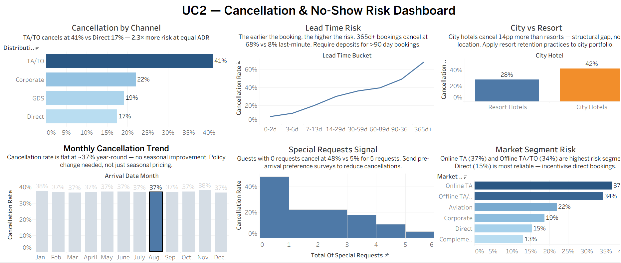
KEY INSIGHTS & BUSINESS RECOMMENDATIONS
1. Cancellation by Channel — TA/TO 41% vs Direct 17%. Shift demand mix toward Direct. Tactical lever: make direct booking meaningfully cheaper or better (early check-in, free parking, flexible dates).
2. Lead Time Risk — 365d+ bookings cancel at 68%. Introduce a non-refundable deposit requirement for all bookings made more than 90 days in advance.
3. City vs Resort — City Hotels cancel at 42% vs Resort 28%. Apply resort retention practices to the city portfolio: pre-arrival personalised communication, local experience suggestions, early check-in incentives. The gap is not about location, it's about perceived commitment to the stay.
4. Monthly Cancellation Trend — flat 37% year-round. Seasonal pricing alone will not fix this. The flat line means the problem is not demand seasonality — it's booking behaviour and policy. This rules out "discount in low season" as a fix. It points squarely at deposit policy and channel mix as the levers, not pricing calendar.
5. Special Requests Signal 0 requests = 48% cancel, 5 requests = 5% cancel. Send a pre-arrival preference survey to every booking within 24 hours of reservation.
6. Market Segment Risk — Online TA 37%, Offline TA/TO 34%, Direct 15%. Direct channel is your most reliable demand source by a wide margin — 15% cancel rate vs 37% for Online TA. The business case for investing in direct booking conversion (a better booking engine, a loyalty programme, a direct rate advantage) is clear in this data. Every booking you convert from Online TA to Direct cuts cancellation risk by more than half.
CONFIDENTIAL · CLEO CEO BRIEFING · JUNE 2026 · DARIA BYSTROVA — IRONHACK PROJECT 5

Slide 9
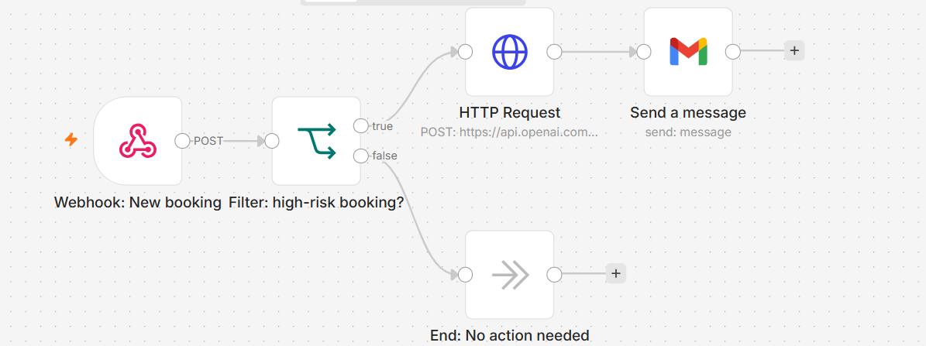
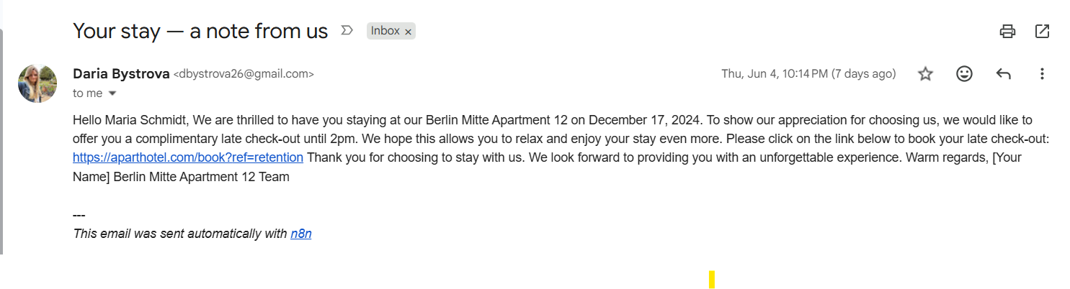
AUTOMATED RETENTION EMAIL
N8N Workflow
2
1
The workflow steps:
Receives a new booking.
Detects it as high-risk.
Sends booking details to OpenAI.
Generates a personalized retention email.
Sends the email via Gmail to reduce cancellation risk.
1
2
The filter marks a booking as high-risk if either of these conditions is true:
A) Lead time is over 90 days
B) Booking channel is Booking.com
C) No prepayment
CONFIDENTIAL · CLEO CEO BRIEFING · JUNE 2026 · DARIA BYSTROVA — IRONHACK PROJECT 5

Slide 10
IMPLEMENTATION PLAN — PHASES, STEPS, OWNERS, GO/NO-GO GATES
Four phases, 14 weeks, each independently valuable — every phase gated by a Go/No-Go before the next budget commitment
PHASE 1 · Wks 1–4
PHASE 2 · Wks 5–8
PHASE 3 · Wks 9–11
PHASE 4 · Wks 12–14
Data pipeline
+ BI dashboard
Cancellation
prediction pilot
Dynamic pricing
rules engine
Scale + automate
guest comms
€18–24K
€35–45K
€42–58K
€28–36K
▸ PMS data audit — validate quality
▸ Deploy n8n retention workflow
▸ Event calendar + occupancy triggers
▸ Roll out to all 12 properties
▸ Connect pipeline → Tableau dashboard
▸ 2 pilot properties — shadow mode
▸ Advisory mode — human approves
▸ Pre-arrival upsell automation
▸ Baseline cancellation metrics visible
▸ Measure cancel rate before vs after
▸ Legal review of OTA rate contracts
▸ Post-stay loyalty re-engagement
HOW TIME ESTIMATES ARE DERIVED
⬥ Go/No-Go: data quality sufficient?
⬥ Go/No-Go: ≥3pp reduction at positive ROI?
⬥ Go/No-Go: revenue managers trust it?
⬥ Go Live — monitoring cadence set
Phase 1 — 4 weeks
Phase 2 — 4 weeks
Phase 3 — 3 weeks
Phase 4 — 3 weeks
PMS audit: vendor SLA 5 days. Pipeline build: 1 analyst, ~3 days/use case (benchmarked). Tableau 6 charts: 3 days. 20% buffer. Source: comparable BI projects, hospitality data teams.
n8n workflow + LLM prompt engineering: 3 days (tested PoC). Shadow mode: minimum 2-week window for statistical significance (n≥200 bookings per property needed to detect 3pp delta).
Rules engine (event calendar + occupancy triggers): 5 days benchmarked. OTA legal review: standard 5 business day turnaround. Advisory mode only — no auto-publish until manager acceptance >80%.
PMS webhook config: ~1 day per city, 2 cities parallel = 2 days. Training sessions: 1hr per city × 12 = 1.5 days. Monitoring setup + Google Sheets audit log: 0.5 day. Total: 1 FTE analyst.
✓ Single source of truth.
✓ Proof AI reduces cancellations.
✓ ADR uplift captured on peak nights.
✓ Full chain on AI. 80% less manual.
CONFIDENTIAL · CLEO CEO BRIEFING · JUNE 2026 · DARIA BYSTROVA — IRONHACK PROJECT 5

Slide 11
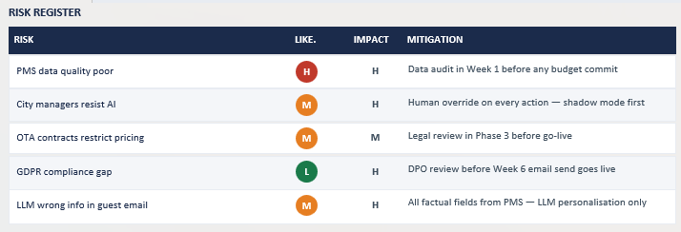
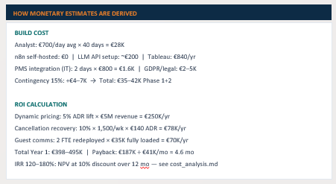
COST, ROI & RISKS — INVESTMENT CASE FOR CLEO
€142–187K total investment, <6-month payback, 120–180% IRR — every risk has a named mitigation built into the phase gates
€142–187K
<6 months
€495K
120–180%
Total build cost
14 weeks
Payback period
(conservative)
Year 1 benefit
(conservative)
Estimated IRR
CONFIDENTIAL · CLEO CEO BRIEFING · JUNE 2026 · DARIA BYSTROVA — IRONHACK PROJECT 5
RISK REGISTER
RISK
LIKE.
IMPACT
MITIGATION
HOW MONETARY ESTIMATES ARE DERIVED
PMS data quality poor
H
H
Data audit in Week 1 before any budget commit
BUILD COST
Analyst: €700/day avg × 40 days = €28K
City managers resist AI
H
Human override on every action — shadow mode first
n8n self-hosted: €0 | LLM API setup: ~€200 | Tableau: €840/yr
M
PMS integration (IT): 2 days × €800 = €1.6K | GDPR/legal: €2–5K
Legal review in Phase 3 before go-live
Contingency 15%: +€4–7K → Total: €35–42K Phase 1+2
OTA contracts restrict pricing
M
M
ROI CALCULATION
GDPR compliance gap
L
H
DPO review before Week 6 email send goes live
Dynamic pricing: 5% ADR lift × €5M revenue = €250K/yr
Cancellation recovery: 10% × 1,500/wk × €140 ADR = €78K/yr
LLM wrong info in guest email
M
H
All factual fields from PMS — LLM personalisation only
Guest comms: 2 FTE redeployed × €35K fully loaded = €70K/yr
Total Year 1: €398–495K | Payback: €187K ÷ €41K/mo ≈ 4.6 mo
IRR 120–180%: NPV at 10% discount over 12 mo — see cost_analysis.md

Slide 12
RECOMMENDATION
Run a pilot — not invest fully, not wait
6–8 weeks · 2 properties · €5–10K · Measurable Go/No-Go at Week 6
WHY NOT INVEST FULLY NOW
WHY NOT WAIT
✕ PMS data quality needs validation
✕ Numa, Limehome, BobW not waiting
✕ GDPR review required before email sends
✕ 71% of operators already using AI
✕ OTA contracts need legal check
✕ OTA commission drains 15–25% every week
✕ City managers need to trust AI first
✕ Window to lead is now — not next year
✓ Groups cancel at 61.1% — non-refundable deposits protect revenue from day one
✓ ADR gap €5 despite 20.9% demand swing — rules engine captures €4–8M annually
✓ n8n workflow tested — real AI email delivered in 2 seconds on real bookings
✓ Every tool call logged, every number cited, every limitation disclosed
DATA · INSIGHT · BETTER DECISIONS
github.com/dbystrova26/project5_analytics_visualization_and_ai_insights

